Slide 1

Advanced Functions
Function Context, First-Class Functions, Referential Transparency, Currying, IIFE, Closure
SoftUni Team
Technical Trainers
Software University
https://softuni.bg

Slide 2
Table of Contents
Execution Context
Functional Programming in JS
Closure
Function Decoration
2
Notes:
2

Slide 3
Have a Question?
sli.do
#js-advanced
Notes:
3

Slide 4
Execution Context
this
Global, Methods, Events, Arrow Functions

Slide 5
Execution Context Review
The function context is the object that owns the currently executed code
Function context === this object
Depends on how the function is invoked
Global invoke: func()
Object method: object.function()
DOM Event: element.addEventListener()
Using call() / apply() / bind()

Slide 6
Inner Method Context
this variable is accessible only by the outer method
const obj = {
name: 'Peter',
outer() {
console.log(this); // Object {name: "Peter"}
function inner() { console.log(this); }
inner();
}
}
obj.outer(); // Window

Slide 7
Arrow Function Context
this retains the value of the enclosing lexical context
const obj = {
name: 'Peter',
outer() {
console.log(this); // Object {name: "Peter"}
const inner = () => console.log(this);
inner();
}
}
obj.outer(); // Object {name: "Peter"}

Slide 8
Explicit Binding
Occurs when call(), apply(), or bind() are used on a function
Forces a function call to use a particular object for this binding
function greet() {
console.log(this.name);
}
let person = { name:'Alex' };
greet.call(person, arg1, arg2, arg3, ...); // Alex

Slide 9
Changing the Context: Call
Calls a function with a given this value and arguments provided individually
const sharePersonalInfo = function (...activities) {
let info = `Hello, my name is ${this.name} and`+ + `I'm a ${this.profession}.\n`;
info += activities.reduce((acc, curr) => {
let el = `--- ${curr}\n`;
return acc + el;
}, "My hobbies are:\n").trim(); return info;
} // Continues on the next slide…

Slide 10
Changing the Context: Call
const firstPerson = { name: "Peter", profession: "Fisherman" };
console.log(sharePersonalInfo.call(firstPerson, 'biking', 'swimming','football'));
// Hello, my name is Peter.
// I'm a Fisherman.
// My hobbies are:
// --- biking
// --- swimming
// --- football

Slide 11
Changing the Context: Apply
Calls a function with a given this value, and arguments provided as an array
apply() accepts a single array of arguments, while call() accepts an argument list
If the first argument is undefined or null a similar outcome can be achieved using the array spread syntax

Slide 12
Apply() – Example
const firstPerson = {
name: "Peter",
prof: "Fisherman",
shareInfo: function () {
console.log(`${this.name} works as a ${this.prof}`);
}
};
const secondPerson = { name: "George", prof: "Manager" };
firstPerson.shareInfo.apply(secondPerson);
// George works as a Manager

Slide 13
Changing the Context: Bind
The bind() method creates a new function
Has its this keyword set to the provided value, with a given sequence of arguments preceding any provided when the new function is called
Calling the bound function generally results in the execution of its wrapped function

Slide 14
Bind – Example
const x = 42;
const getX = function () {
return this.x;
}
const module = {x , getX };
const unboundGetX = module.getX;
console.log(unboundGetX()); // undefined
const boundGetX = unboundGetX.bind(module);
console.log(boundGetX()); // 42

Slide 15
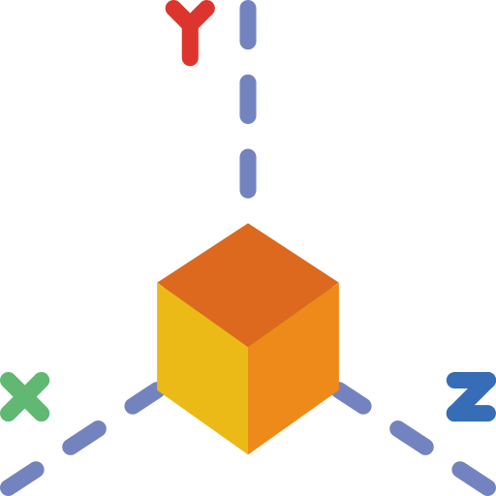
Problem: Area and Volume Calculator
The functions area and vol are passed as parameters to your function
function area() {
return Math.abs(this.x * this.y);
};
function vol() {
return Math.abs(this.x * this.y * this.z);
};

Slide 16
Problem: Area and Volume Calculator
Calculate the area and the volume of figures, which are defined by their coordinates (x, y and z), using the provided functions
'[
{"x":"1","y":"2","z":"10"},
{"x":"7","y":"7","z":"10"},
{"x":"5","y":"2","z":"10"}
]'
[
{ area: 2, volume: 20 },
{ area: 49, volume: 490 },
{ area: 10, volume: 100 }
]

Slide 17
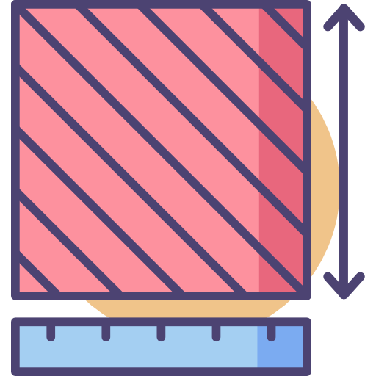
Solution: Area and Volume Calculator
function solve(area, vol, input) {
let objects = JSON.parse(input);
function calc(obj) {
let areaObj = Math.abs(area.call(obj));
let volumeObj = Math.abs(vol.call(obj));
return { area: areaObj, volume: volumeObj }
}
return objects.map(calc);
}

Slide 18

Object Methods as Browser Event Handlers
const person = {
name: "Peter",
respond() {
alert(`${this.name} says hello!`);
}
}
const boundRespond = person.respond.bind(person);
documet.getElementById('callBtn')
.addEventListener('click', person.respond);
documet.getElementById('callBtn')
.addEventListener('click', boundRespond);
Unwanted result
Works as intended

Slide 19
Functional Programming in JS
f(x)
'
'
First Class, Higher-Order, Pure Functions

Slide 20
First-Class Functions
First-class functions are treated like any other variable
Passed as an argument
Returned by another function
Assigned as a value to a variable
The term "first-class" means that something is just a value. A first-class function is one that can go anywhere that any other value can go - there are few to no restrictions.
Michael Fogus, Functional Javascript

Slide 21
First-Class Functions
Can be passed as an argument to another function
function sayHello() {
return "Hello, ";
}
function greeting(helloMessage, name) {
return helloMessage() + name;
}
console.log(greeting(sayHello, "JavaScript!"));
// Hello, JavaScript!

Slide 22
First-Class Functions
Can be returned by another function
We can do that, because we treated functions in JavaScript as a value
function sayHello() {
return function () {
console.log('Hello!');
}
}

Slide 23
First-Class Functions
Can be assigned as a value to a variable
const write = function () {
return "Hello, world!";
}
console.log(write());
// Hello, world!

Slide 24
Higher-Order Functions
Take other functions as an argument or return a function as a result
const sayHello = function () {
return function () {
console.log("Hello!");
}
}
const myFunc = sayHello();
myFunc(); // Hello!

Slide 25
Predicates
Any function that returns a bool based on evaluation of the truth of an assertion
Predicates are often found in the form of callbacks
let found = array1.find(isFound);
function isFound(element) {
return element > 10; //True or false
}
console.log(found); // 12
predicate

Slide 26
Built-in Higher Order Functions
Array.prototype.map
Array.prototype.filter
Array.prototype.reduce
users = [ { name: 'Tim', age: 25 },
{ name: 'Sam', age: 30 },
{ name: 'Bill', age: 20 } ];
getName = (user) => user.name;
usernames = users.map(getName);
console.log(usernames) // [“Tim", "Sam", "Bill"]

Slide 27
Pure Functions
Returns the same result given same parameters
Execution is independent of the state of the system
// impure function:
let number = 1;
const increment = () => number += 1;
increment(); // 2
// pure function:
const increment = n => n + 1;
increment(1); // 2

Slide 28
Referential Transparency
An expression that can be replaced with its corresponding value without changing the program's behavior
Expression is pure and its evaluation must have no side effects
function add(a, b) { return a + b };
function mult(a, b) { return a * b};
let x = add(2, mult(3, 4));
// mult(3, 4)) can be replaced with 12

Slide 29

Closure
Inner Function State

Slide 30
Closure
One of the most important features in JavaScript
The scope of an inner function includes the scope of the outer function
An inner function retains variables being used from the outer function scope even after the parent function has returned

Slide 31
Functions Returning Functions
A state is preserved in the outer function (closure)
const f = (function () {
let counter = 0;
return function () {
console.log(++counter);
}
})();
f(); // 1
f(); // 2
f(); // 3
f(); // 4
f(); // 5
f(); // 6
f(); // 7

Slide 32
Problem: Command Processor
Write a program, which:
Keeps a string inside its scope
Can execute different commands that modify a string:
append() - add str to the end of the internal string
removeStart() - remove the first n characters
removeEnd() - remove the last n characters
print() - print the stored string

Slide 33
Solution: Command Processor
function solution() {
let str = '';
return {
append: (s) => str += s,
removeStart: (n) => str = str.substring(n),
removeEnd: (n) => str = str.substring(0, str.length - n),
print: () => console.log(str)
}
}

Slide 34

Review: DOM Problems
Attempt to solve problems Sections, Locked Profile and Furniture from previous exercises, by using closures to store local state and references

Slide 35
What is IIFE?
Immediately-Invoked Function Expressions (IIFE)
Define anonymous function expression
Invoke it immediately after declaration
(function () { let name = "Peter"; })();
// Variable name is not accessible from the outside scope
console.log(name); // ReferenceError
let result = (function () {
let name = "Peter";
return name;
})();
// Immediately creates the output:
console.log(result); // Peter

Slide 36

Function Decoration
Partial Application and Currying

Slide 37
Partial Application
Set some of the arguments of a function, without executing it
Pass the remaining arguments when a result is needed
The partially applied function can be used multiple times
It will retain all fixed arguments, regardless of context
f = (x, y) => x + y
g = (x) => f(1, x)
Math.pow(x,y)
sqr = (x) => Math.pow(x,2)

Slide 38
Problem: Currency Format
Receive three primitives and a function formatter
The formatter function takes 4 arguments
Use the first three parameters of your solution to create and return a partially applied function that only takes 1 parameter
Sample usage:
const dollarFormatter =
createFormatter(',', '$', true, currencyFormatter);
console.log(dollarFormatter(5345)); // $ 5345,00
console.log(dollarFormatter(3.1429)); // $ 3,14
console.log(dollarFormatter(2.709)); // $ 2,71

Slide 39
Solution: Currency Format
function createFormatter(separator,
symbol,
symbolFirst,
formatter) {
return (value) => formatter(separator,
symbol,
symbolFirst,
value);
}
Partially applied arguments
separator
symbol
symbolFirst

Slide 40
Currying
Currying is a technique for function decomposition
Supply arguments one at a time, instead of at once
They may come from different sources
Execution can be delayed until it's needed
function sum3(a) {
return (b) => {
return (c) => {
return a + b + c;
} } }
console.log(sum3(5)(6)(8)); // 19

Slide 41
Currying Usage
Function Composition - Building new function from old function by passing arguments
Memoization - Functions that are called repeatedly with the same set of inputs but whose result is relatively expensive to produce
Handle Errors - Throwing functions and exiting immediately after an error

Slide 42
Currying vs Partial Application
Currying always produces nested unary functions
Partial application produces functions of arbitrary number of arguments
Currying is NOT partial application
It can be implemented using partial application

Slide 43

Summary
The execution context of a function can be changed using bind, apply and call
JavaScript supports many aspects of the functional programming paradigm
Closures allow a function to maintain state
They are powerful and flexible
Partial application can be used to decorate and compose functions and to delay execution
…
…
…

Slide 44
Questions?
Notes:
44

Slide 45











SoftUni Diamond Partners

Slide 46



Educational Partners

Slide 47

License
This course (slides, examples, demos, exercises, homework, documents, videos and other assets) is copyrighted content
Unauthorized copy, reproduction or use is illegal
© SoftUni – https://about.softuni.bg/
© Software University – https://softuni.bg
Notes:
47

Slide 48
Trainings @ Software University (SoftUni)
Software University – High-Quality Education, Profession and Job for Software Developers
softuni.bg, about.softuni.bg
Software University Foundation
softuni.foundation
Software University @ Facebook
facebook.com/SoftwareUniversity
Software University Forums
forum.softuni.bg
Notes:
48

